Slide 1

CS401 Modern Programming Practices (MPP) Dr. Shafqat Ali Shad
MAHARISHI UNIVERSITY of MANAGEMENT
Engaging the Managing Intelligence of Nature
Computer Science Department

Slide 2
© 2015 Maharishi University of Management, Fairfield, Iowa
All rights reserved. No part of this slide presentation may be reproduced or utilized in any form or by any means, electronic or mechanical, including photocopying or recording, or by any information storage and retrieval system, without permission in writing from Maharishi University of Management.

Slide 3
Lecture 10:Best Programming Practices with Java 8 Living Life in Accord with Natural Law REVIEW: JDBC

Slide 4
JDBC (Optional Module #3)
Executive Summary
Intro to JDBC:
JDBC is the mechanism for a Java application to communicate with a database
Description of JDBC and the architecture of a Java application that uses JDBC
Sample code showing how to connect to a database by way of JDBC

Slide 5
Review of JDBC (Optional Module #3)
Another example of a resource that can be managed with try-with-resources is the Connection object, invoked in interacting with a database, using JDBC. Handling exceptions and closing the connection in the right way and in the right sequence has tended to be error-prone. Using try-with-resources, it is straightforward to write code in the correct way.
Review of JDBC. JDBC is a mechanism that makes it possible for a Java program to communicate with a database system (and other similar data sources) by way of SQL (structured query language) commands.
JDBC APIs facilitate
Making a connection to a database.
Creating SQL or MySQL statements.
Executing SQL or MySQL queries in the database.
Viewing and modifying the resulting records.

Slide 6
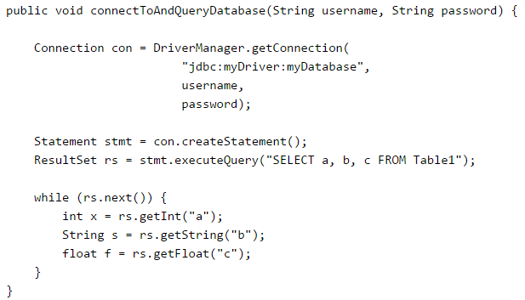
Review of JDBC (Optional Module #3) (cont.)
Simplified code sample (from Oracle tutorial)

Slide 7

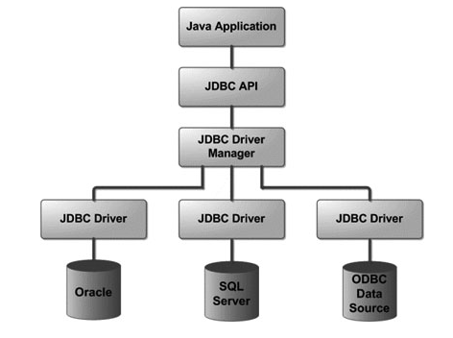
Review of JDBC (Optional Module #3) (cont.)
The JDBC Architecture

Slide 8
Advanced JDBC Programming
Begin with the example given in lesson10.lecture.jdbc.read_trywithres
As in the case of closing a Reader, if a SQLException is thrown in reading the database and another is thrown in attempting to close the Connection, the close exception is appended to the database exception as a suppressed exception.
The implementation style uses try-with-resources just to manage the Connection object; the steps of forming and executing a Statement are handled in an embedded try/catch block.

Slide 9
Handling Transactions and Auto-Generated Keys with JDBC
Transactions enable you to control if, and when, changes are applied to the database. It treats a single SQL statement or a group of SQL statements as one logical unit, and if any statement fails, the whole transaction fails.
To transaction support set the Connection object's autoCommit flag to false. For example, if you have a Connection object named conn, code the following to turn off auto-commit −
conn.setAutoCommit(false);
Once you have executed your SQL code (for insertions, deletions,etc), you commit the changes with a call to the Connection object’s commit() method like this:
conn.commit( );
If an exception is thrown, you can rollback your changes to the database with a call to rollback:
conn.rollback( );
Exception-handling for transaction management can be tricky, but try-with-resources simiplifies the steps.
DEMO: lesson10.lecture.jdbc.transact

Slide 10
Handling Transactions and Auto-Generated Keys with JDBC (cont.)
NOTES:
The demo illustrates the use of PreparedStatements. In a nutshell (for security reasons) whenever an SQL statement has parameters that need to be filled at runtime, the statement should be written using a PreparedStatement.
The Customer unique key field id is auto-generated. After you do an insert, you will often want to know what the value of the id that was generated by the database. The demo illustrates the technique for retrieving this value
RESOURCES:
JDBC and working with transactions are big topics. Here are two excellent follow-up resources:
http://docs.oracle.com/javase/tutorial/jdbc/basics/transactions.html
http://www.tutorialspoint.com/jdbc/index.htm
For practice with SQL, try:
http://www.w3schools.com/sql/sql_intro.asp

